Slide 1
Final Test - Next Week!
Covers everything from week 1 – 9
Review PowerPoint’s, videos, articles and online assignments (including Health & Safety)
Multiple choice and short answer
40 multiple choice and 5 short answer
total of 60 marks
25% of final mark
Notes:
Instructors: give studying tips (not handouts!)

Slide 2
In-Class Activity: Interviews
In groups of two (2) people:
Practice interview questions on the handout provided
One student is interviewer and one is answering questions
If you are interviewer: provide constructive feedback for your partner!
Notes:
Interview activity sheet will be provided

Slide 3
Interview Practice
Give a time in which you set an important goal in the past and tell me about your success in achieving it.
Tell me about a time at work or school when you have worked on a team?
Relate a time in which you had to use your verbal communication skills in order to get an important point across?
Notes:
Could use these examples if you wish – or handout provided

Slide 4
Steps To Your
Successful Co-op

Slide 5
What is Co-op?
Co operative Education is a program which alternates periods of academic study with periods of work experience so the student can apply their classroom learning in appropriate business and industry settings:
Positions are approved by the myCareer Centre/ Advisors
The student is engaged in productive work not only observation
The student’s progress is monitored by their Co-op Advisor
The student is supervised and evaluated by the Co-op employer

Slide 6
ELIGIBILITY REQUIREMENTS
Students are required to achieve ALL of the following to be considered eligible and participate in co-op;
Overall GPA of 2.8, a cumulative GPA of at least 2.8 by the start of Term 3 when eligibility is determined by the co-op advisor
Passed all required courses to date
Registered in current term courses
Fees paid in full
NOTE: Refer to your program map for alternative path if you do not meet the above criteria

Slide 7
DO YOU HAVE A VALID WORK PERMIT?
You need the Work Permit! Different than your Study permit
If you do not have one – request a letter from Lambton in Toronto reception (4th floor)
If unsure, meet with an Immigration Consultant; her schedule and availability can be found on Moodle

Slide 8
Your Co-op Work Term
Credit Requirements:
Completion of Work Term Record contract – including start/end dates
Completion of hours required for the co-op course:
CPL 1049 – 30/40 hours a week, minimum 420 hours - NO maximum and MUST complete co-op until the END of TERM!
Completion of assignments and Work Term Report through online Moodle Modules
Submission of required paperwork at the end of your term (Work Term Report):
Record of Attendance
Supervisor Meeting Form
Employer Evaluation
Notes:
Students should not be ending co-op before the end of term, even if they have secured 420 hours

Slide 9
Securing a Co-op
Co-op is a competitive process – students must apply to and compete for positions
Employers make all the hiring decisions – not Co-op Advisors!
It is key that students;
Actively engage in the finding/securing process
Have competitive marketing materials
Have a professional online profile
Have excellent networking and interview skills

Slide 10
Securing a Co-op
The job market for co-op is very competitive and students are expected to be active participants in their job searches; this includes demonstrated activity on the myCareer Job Posting System.
Lambton College cannot guarantee co-op positions for students. Success in finding a co-op involves a number of factors that are not controlled by Lambton College.
Students will also be expected to canvass employers to find their own opportunities (networking, online, directories & emails, etc.)
Any student who secures his or her own co-op position must verify with the co-op advisor assigned to the program that the proposed co-op is appropriate and will be approved before accepting the position.

Slide 11
Student Responsibilities
Have professional marketing materials (cover letter, resume, etc..)
Keep resume on myCareer up to date
Check myLambton e-mail regularly for communication from Co-op department
Conduct your own job search:
Networking
Lambton College Postings (myCareer)
Outside opportunities
Approach employers directly
Keep a professional online presence (Ex: Facebook)

Slide 12
Policies & Procedures for Co-op
Read & understand and adhere to Policies and Procedures for Co-op:
https://www.mylambton.ca/mycareer/students/Policies_And_Procedures/

Slide 13
myCareer Job Postings
Eligible students will be able to view and apply to jobs through myCareer
Follow instructions carefully in regard to deadlines, how to apply, what is required
You will no longer be able to access jobs once the deadline date has passed

Slide 14
Electronic Work Term Record
No longer using paper contracts; Co-op contract is now a Work Term Record which is completed online through myCareer
PowerPoint instructions (step-by-step) will be emailed to all eligible students in Term 3 – check myLambton email regularly for it
You will be emailed reminders throughout the term along with updates

Slide 15
Required Documents for WTR
Create and complete a Work Term Record - Agreement on myCareer
Attach (and combine if needed) two (2) PDF files:
Copy of Work Permit
Job Posting/Job Description/Job Offer letter - Need roles/responsibilities listed to verify program suitability!!
Workplace Insurance form – Unpaid positions only!
A Workplace Insurance form will be email to all eligible students in Term 3 – remember: only needed for unpaid positions!

Slide 16
Job Acceptance
BEFORE YOU ACCEPT YOUR JOB:
Clarify all details (ex: transportation, location, etc.)
Job description (does it match program capabilities?)
Hours (full time - 30-40 hours for co-op)
Salary
Contract dates (Does it match the term dates?)
Conditions of employment
All job acceptance Work Term Records MUST be submitted within 48 hours of the job offer

Slide 17
CO-OP/ Job Acceptance
Once you accept (verbal or written) you are committed to that position! No Exceptions!
Follow employer timelines for accepting positions
Ask employer for more time to consider acceptance if needed – no more than a week
Create myCareer Work Term Record within 48 hours of job acceptance
Allow 5 business days for Advisor to assess application

Slide 18
CAN YOU ACCEPT MORE THAN 1 CO-OP POSITION?
NO! Verbal acceptance is STILL an acceptance!
Ask for more time to consider the position if needed!
DO NOT leave the employer in the dark – let them know an answer by their deadline
Ask employers for more information if you are unsure

Slide 19
Co-op Success
DURING YOUR CO-OP WORK TERM:
Complete online Moodle modules and required documentation during the work term
Advise employer (first) if late or sick
Email co-op advisor to let us know you will not be at work
Contact the myCareer Centre for unusual circumstances or difficulties
Remember that at all times you are representing your program and Lambton College
Honour your co-op/contract dates – no changes

Slide 20
Company Policies and Procedures
You MUST abide by ALL company policies and procedures while on co-op
If you don’t understand ASK QUESTIONS!
Any disciplinary warning or action MUST be taken seriously
If you are fired you will FAIL co-op and will be place on an unscheduled break / Applied Project following term
In rare cases that students are fired, it is due to behavioural issues!
While on Co-op you are still a Lambton College student

Slide 21
myCareer Centre Website
https://www.mylambton.ca/mycareer/Home/

Slide 22
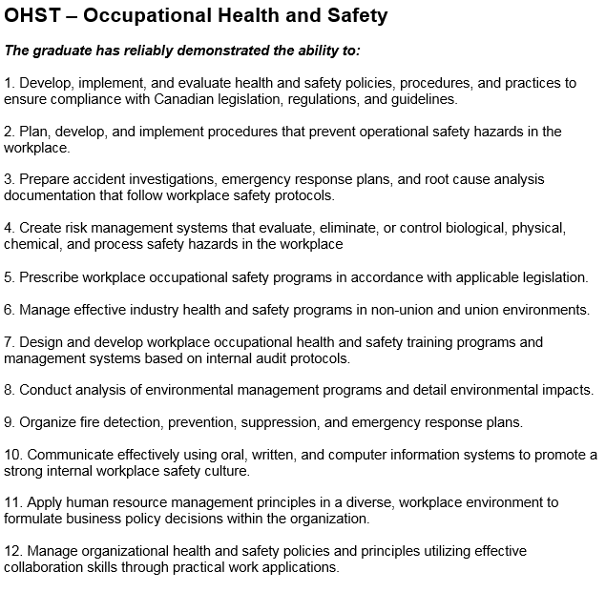
Positions must reflect AT LEAST 50% of your program capabilities:
Notes:
Add in your own Program VLO’s (Vocational Learning Outcomes) also known as Program Capabilities

Slide 23
Appointments With Your Co-op Advisor
There are 2 ways to book meetings with your advisor:
1. Through the myCareer Centre (please check availability here first!):
2. If there are no appointments available on myCareer Centre please e-mail advisor with:
Your name, student number, and program name
Reasons for wanting to meet (some questions can be answered by e-mail)
A list of possible dates and times that you are available
Co-op Advisor for OHST:
Diana McLennan
Co-op & Career Advisor
Diana.McLennan@cestarcollege.com
416-485-8588 EXT 8021
Notes:
Add co-op advisor information

Slide 24
Week #9 – Online Work
Read:
Co-operative Education and Internship Policy
https://www.mylambton.ca/mycareer/students/Policies_And_Procedures/
Co-operative Education and Internship Procedures
https://www.mylambton.ca/uploadedFiles/myLambton/Services/MyCareer_Centre/Students/Procedures%20PDF.pdf
Co-op FAQ’s
https://www.mylambton.ca/mycareer/students/Frequently_Asked_Questions/
Complete: The Co-op Quiz on Moodle

